Slide 1
Virtualization
Need of Virtualization
Reduces the number of physical servers.
Capability of running multiple operating systems and applications on a single computer or server.
Ability to Recover from disaster.
Before Virtualization
Single OS image per machine.
Running multiple applications on same machine often creates conflict.
Inflexible and costly infrastructure.
After Virtualization
Hardware-Independent of Os and applications.
Simple, cost effective high availability for all servers.
Can manage OS and application as a single unit by encapsulating them into Virtual machine.
Automatic restart of Virtual machine in case of server failure.
Zero downtime

Slide 2
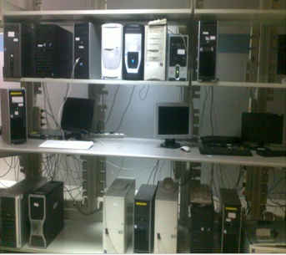
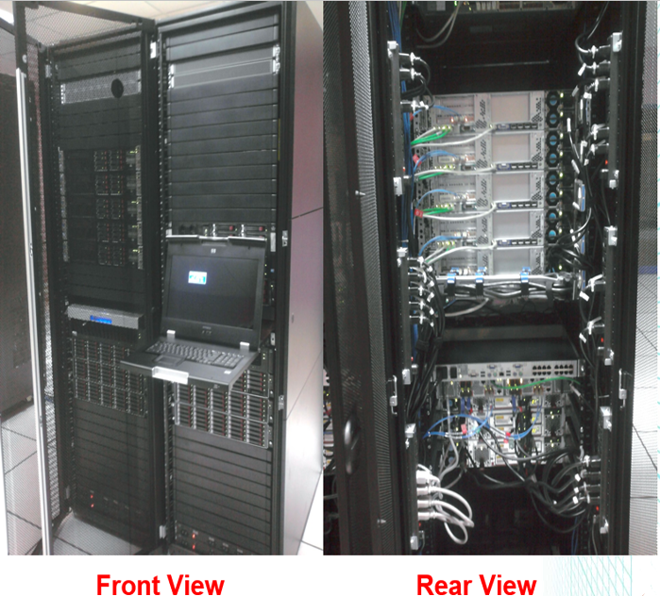
Virtualization
Before Virtualization
After Virtualization

